Slide 1

SEMINAR ON : Boost Model Accuracy of Imbalanced COVID-19 Mortality Prediction Using GAN-based Oversampling Technique.
By : T Bindhu Bhargavi
Roll No: 18WH5A0520
Computer Science And Engineering
BVRIT HYDERABAD College Of Engineering For Women
February 2021

Slide 2
Contents
Abstract
Introduction
GAN
Data Preprocessing
Data Analysis
Evaluation Metrics
Model Comparison
Conclusion
References

Slide 3
ABSTRACT
The model uses the COVID-19 patient's geographical, travel, health, and demographic data to predict the severity of the case and the possible outcome, recovery, or death. The data analysis reveals a positive correlation between patients' gender and deaths, and also indicates that the majority of patients are aged between 20 and 70 years. This paper proposes a fine-tuned Random Forest model boosted by the AdaBoost algorithm.

Slide 4
Introduction
The solved cases and data from these forums or published research publications understand their methodology, and try to improve accuracy or reduce the error with additional steps.
Conventional methods include Random Oversampling (ROS), Synthetic Minority Oversampling Technique (SMOTE) and others can be applied.
The data used in studies were trained using 222 patient records with 13 features.

Slide 5
Generative Adversarial Networks (GAN)
Generative adversarial networks are based on a game-theoretic scenario in which the generator network must compete against an adversary.
As GAN learns to mimic the distribution of data, It is applied in various fields such as music, video, and natural language, and more recently to imbalanced data problems.

Slide 6
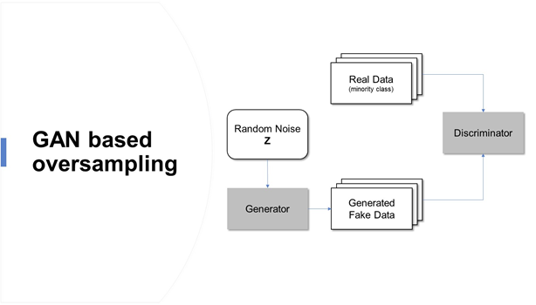
Generative Adversarial Networks (GAN)
Oversampling based on Generative Adversarial Networks(GAN) over comes the limitations of conventional method such as overfitting, and allows the development of a highly accurate prediction model of imbalanced data
Fig 1: GAN BASED OVERSAMPLING https://cdn.Analytics.Com/wp-content/uploads/2020/10/image2-2.Png

Slide 7
How GAN generate synthetic data?
Two neural networks compete against each other to learn the target distribution and generate artificial data.
A generator network training samples to fool the discriminator.
A discriminator network D: discriminate training samples and generated samples.

Slide 8
DATASET
Column | Description | Values (for categorical variables) | Type
id | Patient Id | NA | Numeric
location | The location where the patient belongs to | Multiple cities located throughout the world | String, Categorical
country | Patient’s native country | Multiple countries | String, Categorical
gender | Patient’s gender | Male, Female | String, Categorical
age | Patient’s age | NA | Numeric
sym_on | The date patient started noticing the symptoms | NA | Date

Slide 9
Data Pre-processing
The dataset consists of columns with the data being the Date, String, and Numeric type. We also have categorical variables in the dataset.
Since the ML model requires all the data that is passed as input to be in the numeric form, we performed label-encoding of the categorical variables.
This assigns a number to every unique categorical value in the column.

Slide 10
Defining Generator
The generator takes input from latent space and generates new synthetic samples. The leaky rectified linear activation unit (LeakyReLU) is a good practice to use in both the generator and the discriminator model for handling some negative values.
It is used with the default recommended value of 0.2 and the appropriate weight initializer “he uniform”.
In the output layer, the SoftMax activation function is used for categorical variables and sigmoid is used for continuous variables.

Slide 11
Defining Discriminator
The discriminator model will take a sample from our data, such as a vector, and output a classification prediction as to whether the sample is real or fake.
This is a binary classification problem, so sigmoid activation is used in the output layer and binary cross-entropy loss function is used in model compilation.
The Adam optimization algorithm with the learning rate LR of 0.0002 and the recommended beta1 momentum value of 0.5 is used.

Slide 12
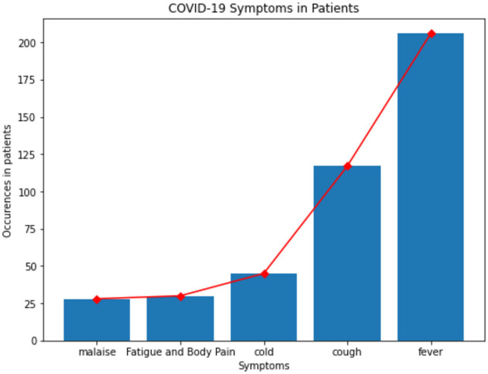
Data Analysis
Fever, cough, cold, fatigue, body pain, and malaise were the most common symptoms that were noticed in patients whose data is available in this dataset.
Correlation between features of the dataset provides crucial information about the features and the degree of influence they have over the target value.
Fig 2 : Symptoms in patients
https://www.Ncbi.v/pmc/articles/PMC7350612/figure/F1/

Slide 13
Evaluation Metrics
The purpose of evaluating the model, is three evaluation metrics.
ACCURACY: Given a dataset consisting of (TP + TN) data points, the accuracy is equal to the ratio of total correct predictions (TP + TN + FP + FN) by the classifier to the total data points. Accuracy is an important measure which is used to assess the performance of the classification model.
Accuracy = TP + TN
TP + TN + FP + FN 0.0<Accuracy<1.0

Slide 14
Precision
Precision is equal to the ratio of the True Positive (TP) samples to the sum of True Positive (TP) and False Positive (FP) samples.
Precision is also a key metric to identify the number of correctly classified patients in an imbalanced class dataset.
Precision = TP
TP + FP

Slide 15
Recall
Recall is equal to the ratio of the True Positive (TP) samples to the sum of True Positive (TP) and False Negative (FN) samples.
Recall is a significant metric to identify the number of correctly classified patients in an imbalanced class dataset out of all the patients that could have been correctly predicted.
Recall = TP
TP + FN

Slide 16
F1 Score
F1 Score is equal to the harmonic mean of Recall and Precision value.
The F1 Score strikes the perfect balance between Precision and Recall thereby providing a correct evaluation of the model's performance in classifying COVID-19 patients.
This is the most significant measure that we will be using to evaluate the model.
F1 Score = 2 × Precision × Recall
Precision + Recall

Slide 17
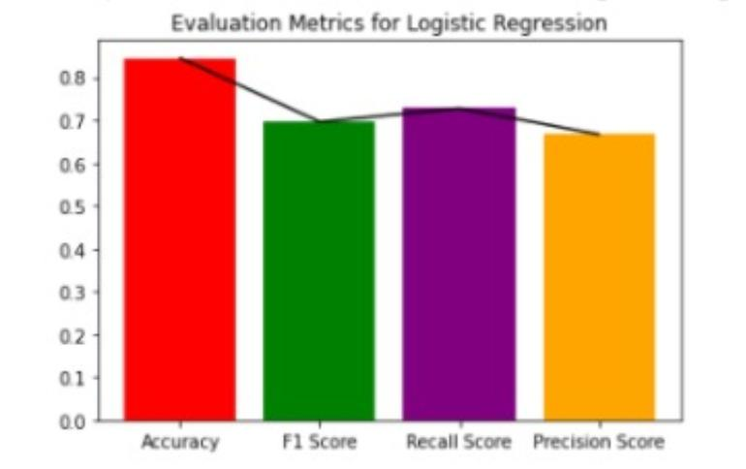
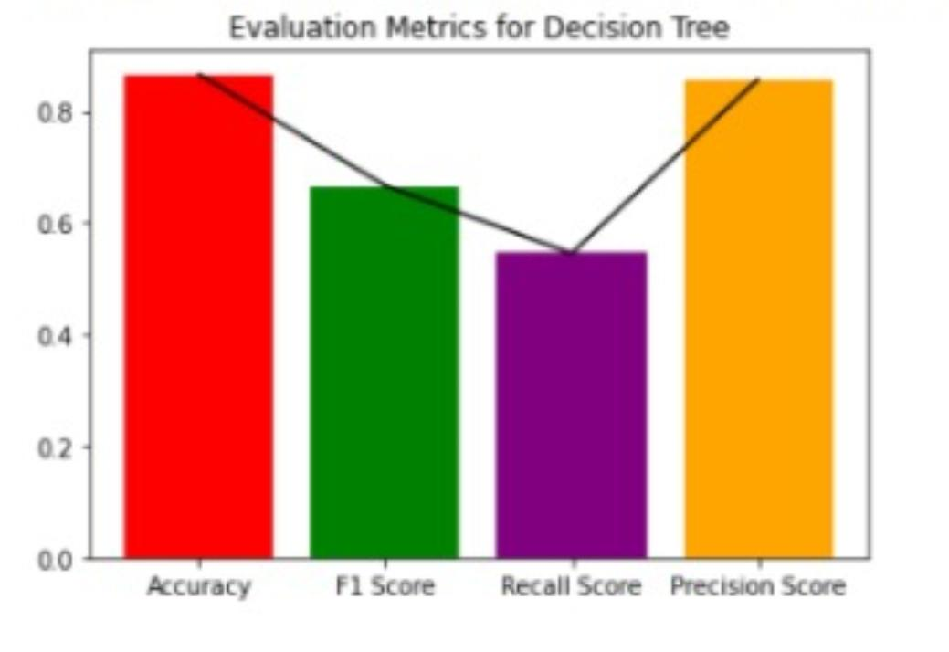
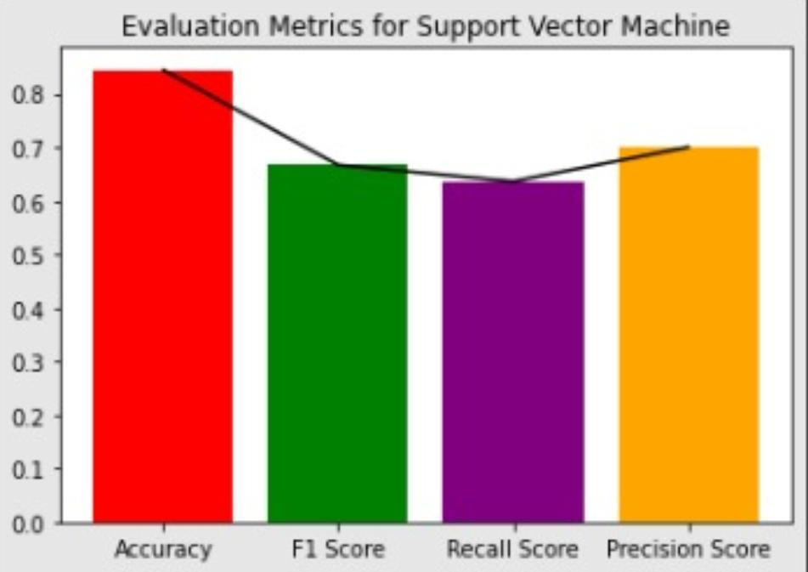
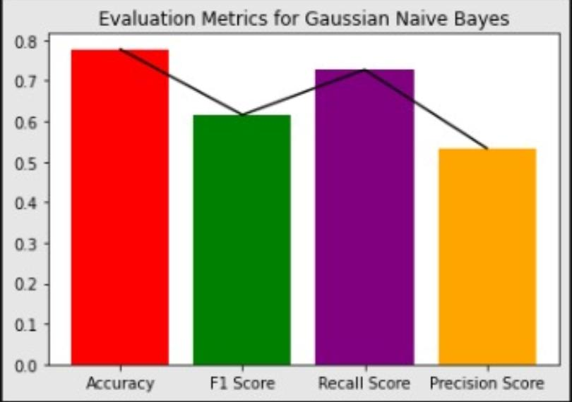
Evaluation Metrices

Slide 18
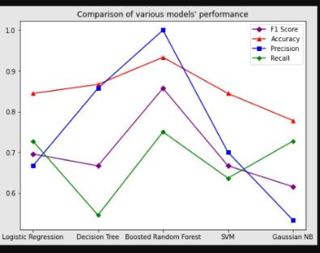
Model Comparison
The model performance is tested on the actual (original) split test data.
After splitting the original data into train and test, generated data from GAN is added to the train data to compare the performance with the base model.
FIG 3 : Comparison of Various Models

Slide 19
Model Comparison
Metric | Score of Base Model* | Score with Augmented Generated Data
Recall Score | 0.75 | 0.83
Precision Score | 1 | 1
F1 Score | 0.86 | 0.9
Accuracy | 0.9 | 0.95

Slide 20
CONCLUSION
The proposed model provides a more accurate and robust result compared to that of the based model, showing that GAN-based oversampling overcomes the limitations of the imbalanced data and it appropriately inflates the minority class.

Slide 21
References
[1] WHO Situation Report-94 Coronavirus disease 2019 (COVID-19) (2020).
[2] Sujatha R, Chatterjee JM, Hassanien AE. (2020).
[3] Huang G, Liu Z, Van Der Maaten L, Weinberger KQ (2017).
[4] Kathiresan S, Sait ARW, Gupta D, Lakshmanaprabu SK, Pandey HM (2020).] He K, Zhang X, Ren S, Sun J (2016) Deep residual learning for image recognition.
[5] Huang G, Liu Z, Van Der Maaten L, Weinberger KQ (2017) Densely connected convolutional networks.

Slide 22
Data Availability Statement
Novel Corona Virus 2019 Dataset (accessed April 23, 2020).
Bayes C, Valdivieso L. Modelling death rates due to COVID-19: a Bayesian approach.arXiv.(accessed May 5, 2020).
The datasets presented in the study can be found in online repositories.
GitHub repository Link :
https://github.com/bindhu520/Boost-Model-Accuracy-of-Imbalanced- COVID-19-Mortality-Prediction-Using-GAN-based-Oversampling-Techni

Slide 23
THANK YOU

